Slide 1
Lenovo Project
Colton Daymude, Nick Houghton, Clare lohrmann,
Kevin Olmsted, Reni Renee, chris sowden, greg terlecky

Slide 2
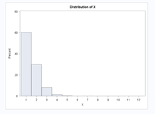
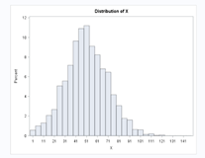


Distributions
Personal Orders
Commercial Orders
Follows a Poisson Distribution
$X= 1+\sum{(Poisson, λ)}$
Follows a normal distribution
$X= floor(1+rand\left(Normal, μ, σ\right))$
Notes:
We are presenting theoretical solution first, right? You do not have to put it on the ppt, but when you present, say explicitly we present to solutions.
I would put a reference to the research paper we used on this slide.

Slide 3
Theoretical
Used the paper ORDER-FULFILLMENT PERFORMANCE MEASURES IN AN ASSEMBLETO-ORDER SYSTEM WITH STOCHASTIC LEADTIMES
https://faculty.fuqua.duke.edu/~jssong/bio/Publications/atoqueue.pdf
Two types of distribution: Poisson and Normal
Poisson distribution
Used to calculate personal orders
Normal distribution
Used to calculate commercial orders

Slide 4
Pseudo code
Read the csv file
Sort data by part-number and finished good
Separate data set into two different groups, using finished goods to create two different data sets
Finished good 209MH32 output as computer 1
Finished good 209MH52 output as computer 2
Rename quantity as q1 for computer 1 and q2 for computer
Merge computer 1 and computer 2 by part number
If q1 is missing, then $q1=0$
If q1 is missing, then 𝑞1=0
If q2 is missing, then $q2=0$
If q2 is missing, then 𝑞2=0
Notes:
why sorting is necessary?
when you “separate data set”, what are you separating? the mapping between FGs and parts?
q1 and q2 are not the terms used in the paper, the Lenovo person may ask “what if we have 100 computer model? do we have to define 100 variables from q1 to q100? Can this code be extended/scalable?”
Address those issues, or prepare your presentations accordingly.

Slide 5
Create a function that will show parts that are shared
Create a variable for personal computer orders and one for commercial orders as a configurable variable. (Percentage should equal 100%)
Generate a random number of orders from 1 to 10,000 as a configurable variable
Create $λ \left(set to .5\right), μ \left(set to 50\right), σ (set to 20),$and a scale (set to .75)
Create 𝜆 (𝑠𝑒𝑡 𝑡𝑜 .5), 𝜇 (𝑠𝑒𝑡 𝑡𝑜 50), 𝜎 (𝑠𝑒𝑡 𝑡𝑜 20), and a scale (set to .75)
The scale value should be between 0 and 1
Where $q1 ≠0$and $q2 ≠0 ($Output should be 10 out of the 155)
Where 𝑞1 ≠0 and 𝑞2 ≠0 (Output should be 10 out of the 155)
Notes:
From last slide to the next, the pseudo code we present is a little to long. Can we do a flow chart with boxes (like slide 7)?
“shared items”: you mean parts, right? let’s use Lenovo’s terms
How do you define “shared parts”? the parts shared by at least two FGs, or shared by all of the FGs? (think about the extensibility of your solution)
What are lambda and mu? (I know your answer, but you should be prepared to explain)
I would replace “global” with “configurable”.

Slide 6
Build data to have the number of orders
Calculate the personal and commercial orders:
If order greater than (personal orders/100) times order variable, then do:
If order is less than or equal to (personal orders/100) times order variable, then do:
Create ordertype column as personal
$$X=1+ random(Poisson, λ)$$
𝑋=1+ 𝑟𝑎𝑛𝑑𝑜𝑚(𝑃𝑜𝑖𝑠𝑠𝑜𝑛, 𝜆)
Create ordertype column as commercial
$$X= floor(1+ random(normal, μ, σ))$$
𝑋= 𝑓𝑙𝑜𝑜𝑟(1+ 𝑟𝑎𝑛𝑑𝑜𝑚(𝑛𝑜𝑟𝑚𝑎𝑙, 𝜇, 𝜎))
Order =1 to max number of orders set by the global variable number of max orders

Slide 7
Plot personal and commercial to see distribution
Create variable that will create computer 1 and computer 2 with a random number of 1's and 2's with step of .5
Merge data together and create new value called stored
Create quantity as $x1 ∗q1 + x2 ∗ q2$
If $q1 ≠0$ and $q2 ≠0$, then shared = Yes, else is No.
Create quantity as 𝑥1 ∗𝑞1 + 𝑥2 ∗ 𝑞2
If 𝑞1 ≠0 and 𝑞2 ≠0, then shared = Yes, else is No.
If x1 is missing, then $x1= x−x2$
If x2 is missing, then $x2 = x−x1$
If x1 is missing, then 𝑥1= 𝑥−𝑥2
If x2 is missing, then 𝑥2 = 𝑥−𝑥1
If new variable equals 2
$$x1= min⁡(rand(′Poisson′, 1+scale ∗ X), floor(x/2))$$
If new variable equals 1
x$2 = (rand(′Poisson′, 1 +scale ∗ X), floor(x/2))$
If new variable equals 2
𝑥1= min⁡(𝑟𝑎𝑛𝑑(′𝑃𝑜𝑖𝑠𝑠𝑜𝑛′, 1+𝑠𝑐𝑎𝑙𝑒 ∗ 𝑋), 𝑓𝑙𝑜𝑜𝑟(𝑥/2))
If new variable equals 1
x2 = (𝑟𝑎𝑛𝑑(′𝑃𝑜𝑖𝑠𝑠𝑜𝑛′, 1 +𝑠𝑐𝑎𝑙𝑒 ∗ 𝑋), 𝑓𝑙𝑜𝑜𝑟(𝑥/2))
Notes:
My guess is you are planning to show your results on Jupyter, right? prepare to show:
if we want to have 80% serviceability on all the FGs, what are the expected serviceability for all the parts?
What if we take out the category of commercial orders and only leave personal orders? (or make the commercial orders 0% in all the orders) Does the program still produce the correct solution?
What if we want to have 0% serviceability on all the FSs? can we produce reasonable output?
What if we want to have 100% serviceability on all the FSs? can we produce reasonable output?

Slide 8
Generates:
List of Finished Goods 1-5
Similated
Corporate
Orders
(Large)
List of Orders
Similated Personal Orders
(Small)
Create Order Quantities for Simulations
Similate Inventory Levels
Attempt
To
Fill Orders
Service-ability
Finished Good Level
Service-ability
Part Level
Program Flow

Slide 9
Inventory Simulation
Input:
Number of Simulations
List of Noise Ratios:
Simulates Inventory
Random sample:
Generates:
order quantities
Pseudo:
Take order list and parts list:
From a random sample of these lists:
Create:
order quantities
Output these values

Slide 10
Order Fulfilment
Input:
Order quantity list
Inventory level list
Prepare for data:
Formats input
Creates:
Dataframe
Columns for calculations
Pseudo:
For the order and quantity lists:
Create fulfilment data:
For each item within data:
Create a place for serviceability values
Output values

Slide 11
Serviceabilities
Input:
Dataframe
From order fulfilment
Processing:
Calculates mean:
Fulfilment rates by:
Parts
Finished goods
Deliverables Generated
Pseudo:
For each row in dataframe:
Calculate mean:
Parts in stock/total needed
Orders completed/total requested
Output seviceability percent based on these calculations.

Slide 12
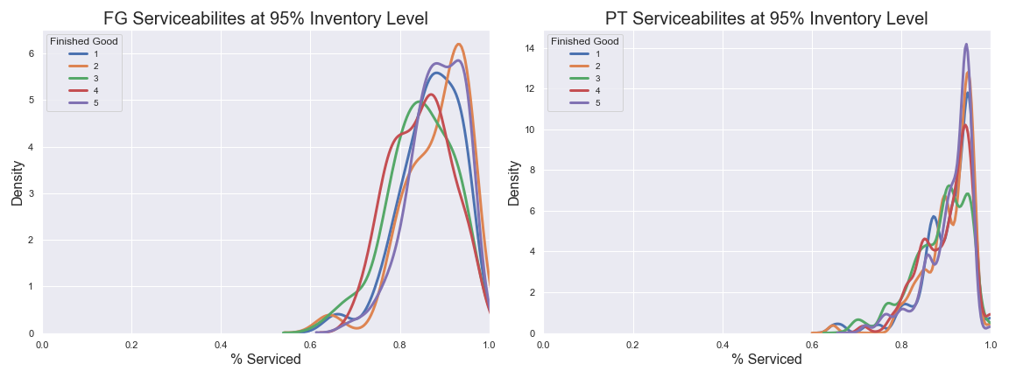
Serviceability Distributions – 95%

Slide 13
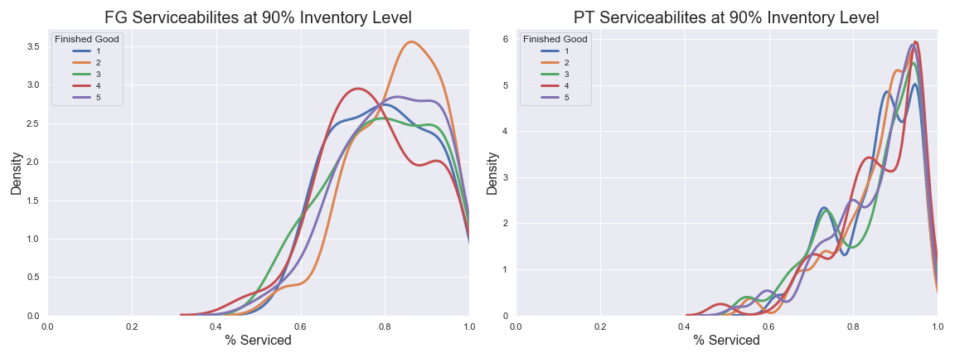
Serviceability Distribution – 90%

Slide 14
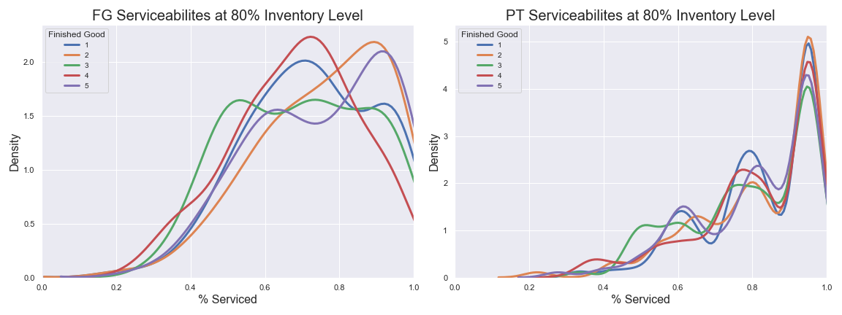
Serviceability Distribution – 80%

Slide 15
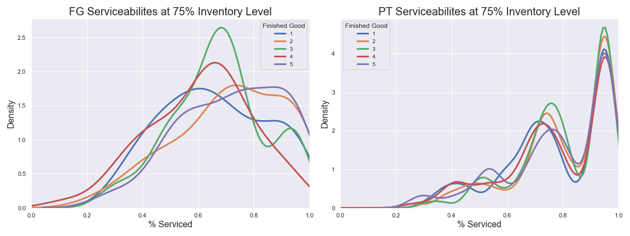
Serviceability Distribution – 75%

Slide 16
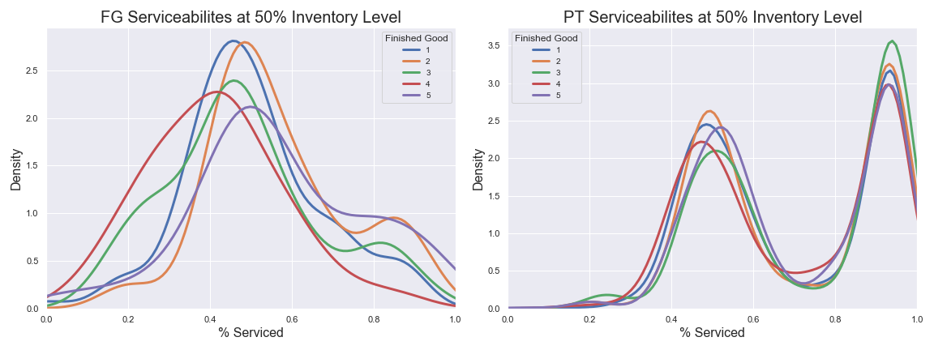
Serviceability Distribution – 50%

Slide 17
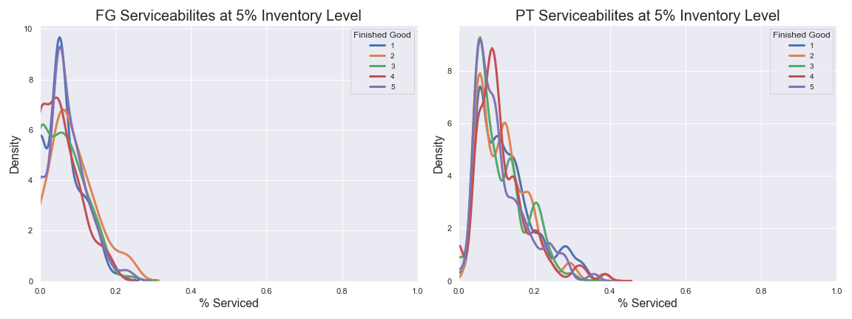
Serviceability Distribution – 5% **Extreme Case

